Slide 1
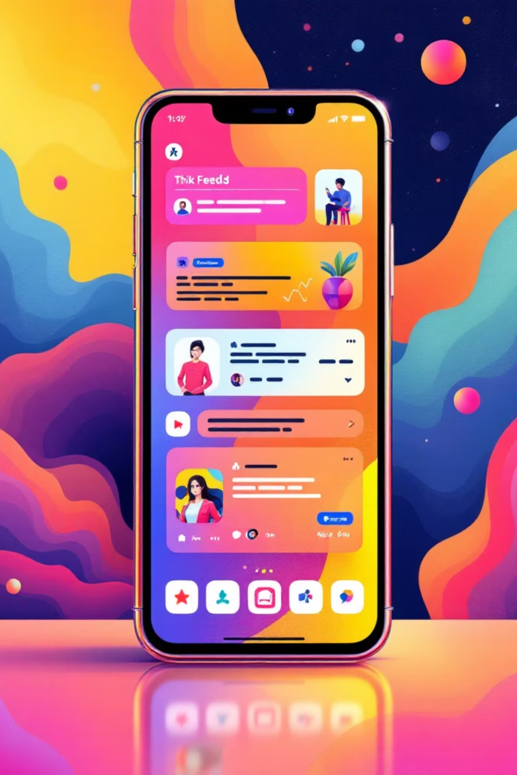
Social Mood Matcher
AI-Powered Social Media Caption & Hashtag Generator

Slide 2



The Challenge
Time-Consuming
Platform Complexity
Content creators spend hours crafting captions and researching hashtags
Different character limits across Twitter, Instagram, and Facebook
Engagement Gap
Difficulty matching content mood with trending hashtags

Slide 3

Intelligent Solution
AI-Powered Platform
Social Mood Matcher uses GenAI to deliver personalized, sentiment-aware captions and trending hashtags optimized for different platforms.
BLIP for image captioning
DistilBERT for sentiment analysis
Gemini 2.5 Flash for enhanced quality

Slide 4
Core Features
Image Analysis
Caption Styles
Detects visual content and mood using BLIP and DistilBERT
Generate casual, aesthetic, professional, or playful captions
Trending Hashtags
Multi-Platform
Curated 2024 hashtags by category and sentiment
Auto-formatted for Twitter, Instagram, and Facebook

Slide 5





Use Case: Food Photography
Upload Image
Cozy soup photo detected
AI Analysis
BLIP + DistilBERT detect "cozy" and "warm" sentiment
Generate Content
Casual caption: "Nothing beats a warm bowl of homemade soup on a chilly evening"
Platform Ready
#FoodPhotography #CozyVibes #Homemade formatted for Twitter (280 chars)

Slide 6

Use Case: Travel Content
Multi-Style Generation
Sunset beach photo detected with "peaceful" and "aesthetic" mood
Aesthetic: "Golden hour whispers stories only the ocean knows"
Punchy: "Sunset state of mind"
Casual: "Beach sunsets hit different"
Gemini-enhanced mode provides multiple variants with platform-optimized hashtags

Slide 7
Architecture Overview
01
02
03
Frontend UI
Image Sentiment Detector
Caption Generator
Streamlit interface with image upload, style selection, platform targeting
BLIP for scene understanding, DistilBERT for sentiment classification
Style-based generation with casual, aesthetic, professional, playful options
04
05
Hashtag Engine
Character Limiter
Trending 2024 hashtags by category and sentiment with priority selection
Platform-optimized truncation preserving message integrity

Slide 8
Platform Comparison
Twitter/X
Instagram
Facebook
280 characters
2,200 characters
63,206 characters
Prioritizes caption, intelligently truncates hashtags
Rarely needs truncation, full content usually fits
Almost never needs character limiting

Slide 9
Development Milestones
Milestone 1
1
Environment setup, dependencies, Gemini configuration
2
Milestone 2
Core services: sentiment detector, caption generator, hashtag engine
Milestone 3
3
Backend integration, session state, error handling
4
Milestone 4
UI development, responsive Streamlit interface
Milestone 5
5
Testing, optimization, deployment preparation

Slide 10
Future Enhancements
Video Analysis
Multi-Language
Support for video content processing
Caption generation in multiple languages
Analytics
Batch Processing
Social media performance integration
Multiple image handling
Brand Voice
Direct Posting
Custom style training
Auto-publish to platforms

